Slide 1


BSIT 2-A
INTRODUCTION
TRAFFIC VIOLATION TRACKER
Prepared by
Jaymark L. Loyola

Slide 2
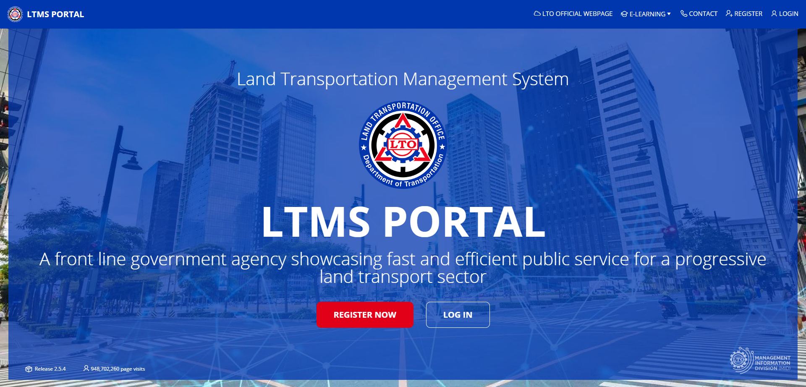
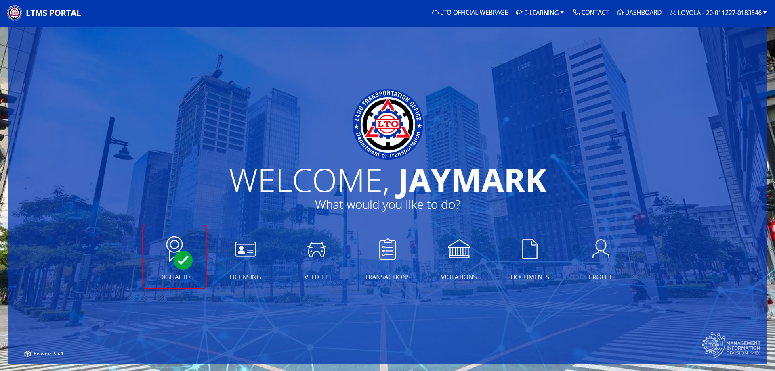

Slide 3

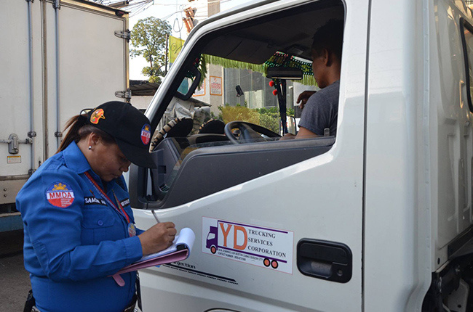

STAKEHOLDERS
ADMIN/USER OF THE SYSTEM
User/s are not allowed to access update/delete violator and manage vehicle information to avoid bribery and extortion
Admin/s are able to access all options of the system

Slide 4
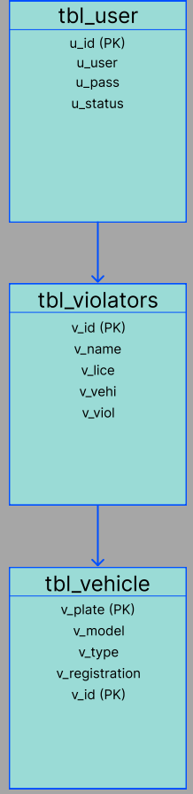
ENTITY RELATIONSHIP DIAGRAM
DATABASE AND DATA

Slide 5
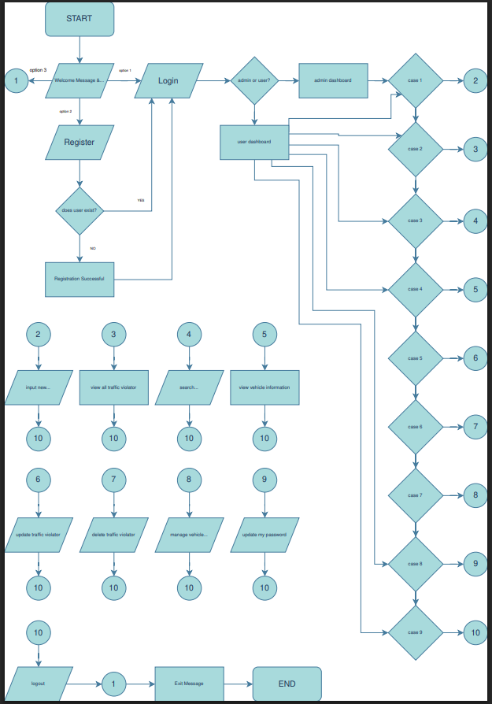

Slide 6
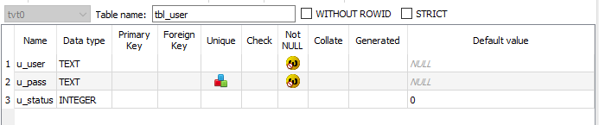
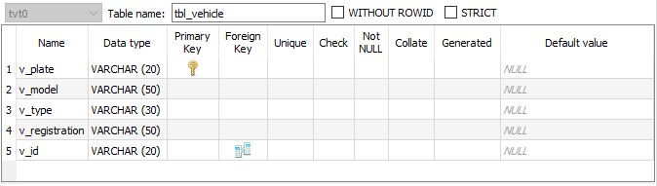
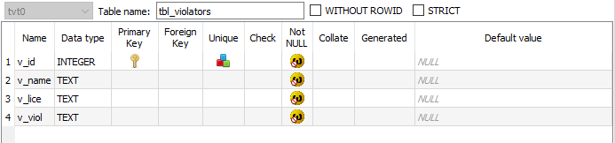

Slide 7
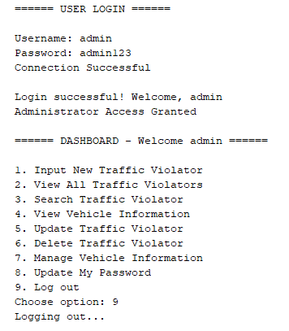

Slide 8
DEMONSTRATION

Slide 9
REFLECTION

